Slide 1


Slide 2
There are three computer architectural classification schemes
The Flynn’s classification scheme
The Feng’s classification scheme
The Handler’s classification scheme

Slide 3

. Two types of information flow into a processor: instructions and data.
The instruction stream is defined as the sequence of instructions performed by the processing unit.
The data stream is defined as the data traffic exchanged between the memory and the processing unit.

Slide 4
According to Flynn's classification, either of the instruction or data streams can be single or multiple.
Computer architecture can be classified into the following four distinct categories:
single-instruction single-data streams (SISD);
single-instruction multiple-data streams (SIMD);
multiple-instruction single-data streams (MISD); and
Multiple-instruction multiple-data streams (MIMD).

Slide 5

This represents the organization of a single computer containing a CU, a Processor Unit, and a MU.
Instructions are executed sequentially and the system may or may not have internal parallel processing capabilities.
Parallel processing may be achieved by means of multiple functional units or by pipeline processing.
IS
CU
PU
MM
IS DS

Slide 6

This class corresponds to array processors.
There are multiple processing elements supervised by the same control unit.
All PEs receive the same instruction broadcast from the CU but operate on different data sets from distinct data streams.
The shared memory subsystem may contain multiple modules.

Slide 7
DS1
DS2
DSn
Shared
Memory
PU1
MM1
PU2
MM2
CU
IS
MMn
PUn

Slide 8

There are n processor units, each receiving distinct instructions operating over the same data stream and its derivatives.
The result of one processor become the input of the next processor in the macro pipe.
MISD structure is only of theoretical interest since no practical system has been constructed using this organization.

Slide 9
IS1
IS2
ISn
CU1
IS1
IS2
ISn
PU1
DS
SM
CU2
PU2
MM1
MM2
MMm
CUn
PUn
DS

Slide 10

MIMD organization refers to a computer system capable of processing several programs at the same time.
Most multiprocessor systems and multiple computer systems can be classified into this category.
An intrinsic MIMD computer implies interactions among the n processors because all memory streams are derived from the same data space shared by all processors.

Slide 11
IS1
IS2
ISn
IS1
IS2
ISn
DS1
DS2
DSn
IS1
IS2
ISn
CU1
CU2
CUn
PU1
PU2
PUn
MM1
MM2
SM
MMm

Slide 12

Feng’s classification is mainly based on degree of parallelism to classify parallel computer architecture.
The maximum number of binary digits(bits) that can be process per unit time is called maximum parallelism degree P.
Pi is the number of bits that can be processed within the i’th processor cycle

Slide 13
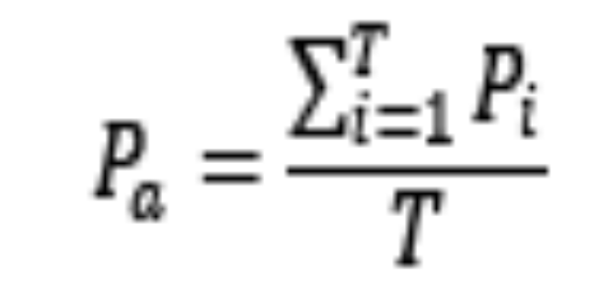
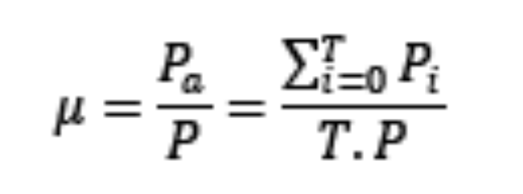
The average parallelism degree 𝑃
Where T is a total processor cycle
The utilization of computer system within T cycle is given by:
When 𝑃𝑖=𝑃 it means that utilization of computer system is 100%.
The utilization rate depends on the application program being executed.
?

Slide 14
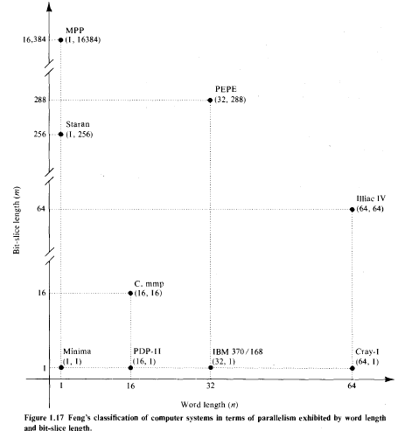


Slide 15
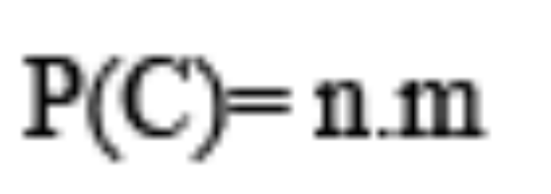
In above fig horizontal axis shows word length n and vertical axis corresponds to the bit-slice length m.
A bit slice is a string of bits, one from each of the words at the same vertical bit position.
The maximum parallelism degree P(C) of a given computer system C is represented by the product of the word length n and the bit-slice length m

Slide 16
The pair (n,m) corresponds to a point in the computer space shown by the coordinate system in fig.
The P(C) is equal to the area of the rectangle defined by integers n and m.
There are four types of processing methods that can be observed from the diagram:
Word –serial and bit-serial(WSBS)
Word –parallel and bit-serial(WPBS)
Word –serial and bit-parallel(WSBP)
Word –Parallel and bit-parallel(WPBP

Slide 17
WSBS has been called as bit –serial processing because one bit (n=m=1) is processed at a time, which was a slow process.
This was done in only first generation computers
WPBS (n=1,m>1) has been called bis(bit-slice) processing because an m-bit slice is processed at a time.

Slide 18
WSBP(n>1,m=1) has been called word-slice processing because one word of n bits is processed at a time.
These are found in most existing computers
WPBP (n>1,m>1) is known as fully parallel processing, in which an array of n.m bits is processed at a time.
This is the fastest mode of the four .

Slide 19

Wolfgang Handler has proposed classification scheme for identifying the parallelism degree and pipelining degree built into the hardware structure of a computer system.
He considers at three subsystem levels:
Processor Control Unit (PCU)
Arithmetic Logic Unit (ALU)
Bit Level Circuit (BLC)

Slide 20
Each PCU corresponds to one processor or one CPU.
The ALU is equivalent to Processor Element (PE).
The BLC corresponds to combinational logic circuitry needed to perform 1 bit operations in the ALU

Slide 21
A computer system C can be characterized by a triple containing six independent entities
T(C) = <K x K', D x D', W x W' >
Where K = the number of processors (PCUs) within the computer
D = the number of ALUs under the control of one CPU
W = the word length of an ALU or of an PE
W' = the number of pipeline stages in all ALUs or in a PE
D' = the number of ALUs that can be pipelined
K' = the number of PCUs that can be pipelined

Slide 22
The CDC 6600 has a single main processor supported by 10 I/O processors.
One control units coordinates one ALU with a 60-bit word length.
The ALU has 10 functional units which can be formed into a pipeline.
The 10 peripheral I/O processors may work in parallel with each other and with the CPU. Each I/O processor contains one 12-bit ALU.

Slide 23
The description for the 10 I/O processors is:
CDC 6600 I/O = (10, 1, 12)
The description for the main processor is:
CDC 6600 main = (1, 1 * 10, 60)
The main processor and the I/O processors can be regarded as forming a macro-pipeline so the '*' operator is used to combine the two structures:
CDC 6600 = (I/O processors) * (central processor) = (10, 1, 12) * (1, 1 * 10, 60)

